Slide 1


Tapestry at St. James’ CE Primary School
Parent Information

Slide 2
Tapestry Online Learning Journal

Slide 3
What is Tapestry?
Tapestry is an online learning journal system
There is an app and browser version available
We can use it to record children’s learning and development using tablet devices and PCs
We can set you up as parents with your own secure logins so you can view, comment on and add your own observations to their child’s journal
When your child leaves, we can export a PDF copy of your child’s journal and a ZIP file including photos and videos for you
If they move to another setting also using Tapestry, their journal can be transferred across as well as your account

Slide 4
Why are we using Tapestry?
It creates a two way communication between us (the staff), and you (the parents/guardians/carers)
We can upload media, meaning you can see pictures and videos of what your child is really up to whilst they are with us
There are greater opportunities to extend your child’s learning at home and add your own observations
Unlike a physical, hard copy book, it’s easy to share with groups of relatives, such as extended families, separated parents and relatives living overseas

Slide 5
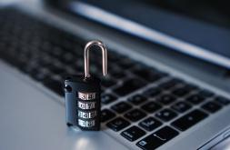
How is the data kept safe?
A password is required to access Tapestry, remember the stronger the password you set, the more secure your account is
You are linked manually to your child/children so you can only view observations for them
We don’t need to store any of the data entered onto Tapestry, they store it for us on secure cloud servers within the EU
Data is stored separately for each school
Tapestry’s developers and support personnel require our permission to access our Tapestry account
For more information about Tapestry security you can go on their website https://tapestry.info/security.html

Slide 6
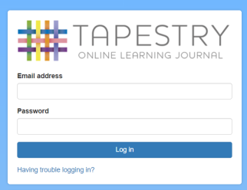
Logging in
To login to Tapestry we will need to have an email address for you
Once you activate your account you can then login using your email and password
You can reset your password by email if you forget it
Passwords are case sensitive
Remember to set a strong password
You can read this article for some guidance on how to set a strong and memorable password https://eyfs.info/forums/topic/47249-password-setting-advice/

Slide 7
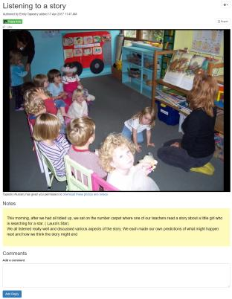
Observations
When you login to your account you will be able to see any observations for your child that have been added to their journal
You will be able to see any photos/videos/audio files/documents attached to the observation, though if it’s a group one, this will depend on whether all of you giving your consent for other relatives to see photos/videos including your child
Underneath the media you will see the notes, so the actual observation
You will also be able to add comments and like the observation
You can also add your own observations

Slide 8
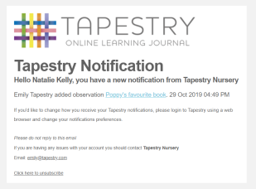
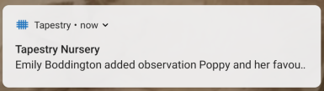
Notifications
If you would like to receive notifications it’s possible to receive email notifications immediately, daily or weekly
There are different notifications for things like new observations and observation comments

Slide 9
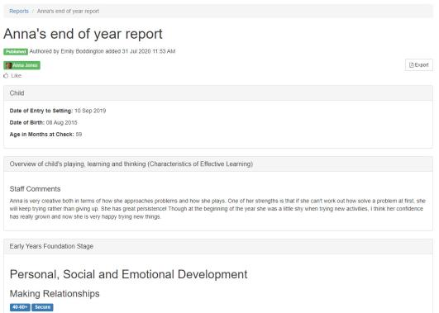
Reports
This allows us to create reports at the end of the year and share these with you
They may include documents which you can download

Slide 10
When will we get started?
We will shortly hand out introductory letters, and user guides, and forms so you can grant your permission and provide an email address, please note that it’s not possible for parents to both be set up using the same email address
We should have your account created by the end of the month, and you will receive a link to set a password for yourself, remember to check your spam/junk folders for this
You can try it out on a Tablet we have set it up on in a few moments

