Slide 1

Welcome to Year 1

Slide 2
Staff in Year 1
Class teachers
Mrs Piscitelli & Mrs Charalambous
Support staff
Mrs Darby & Mrs James

Slide 3
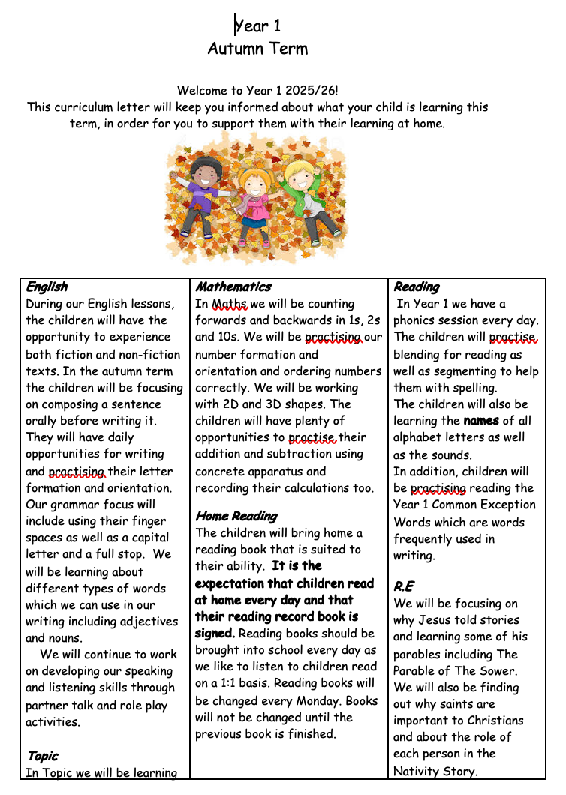
Autumn Newsletter
Class teachers
Mrs Piscitelli & Mrs Charalambous
Support staff
Mrs Derby & Mrs James

Slide 4
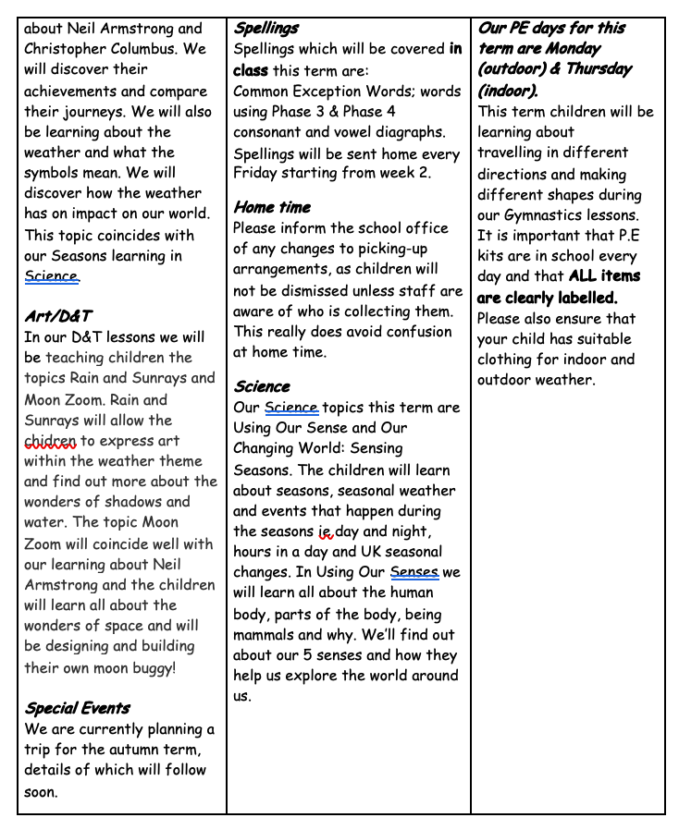

Slide 5
Reminders :
Please remember that:
Water bottles are needed in school every day
Children are expected to read at home every day
Reading records should be signed every day & brought into school
New reading books will be changed every Monday
Phonics homework will be sent home every day
Handwriting homework will be sent home every week
All items of clothing/ school uniform must be labelled with your child’ name

Slide 6
Thank You!

