Slide 1

Meet the Teacher – Year 3 Autumn Term
Parents & Carers Information Session
Autumn 2025

Slide 2

Welcome
• Welcome back to school!
• We are excited to work with you and your child this year.
• Teachers: Mrs Khan & Mrs Williams
• Additional support: Miss Bibi

Slide 3


Reading
• Children must bring reading book & diary daily.
• Daily reading at home – parents/carers to sign.
• Guided reading through Little Wandle phonics or VIPERS.
• Class library books for independent reading.
• Reading = cornerstone of learning.

Slide 4


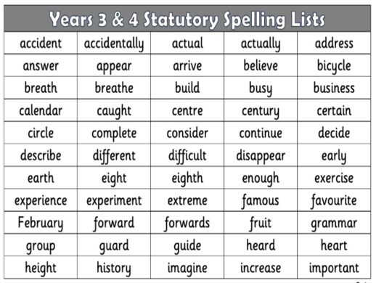
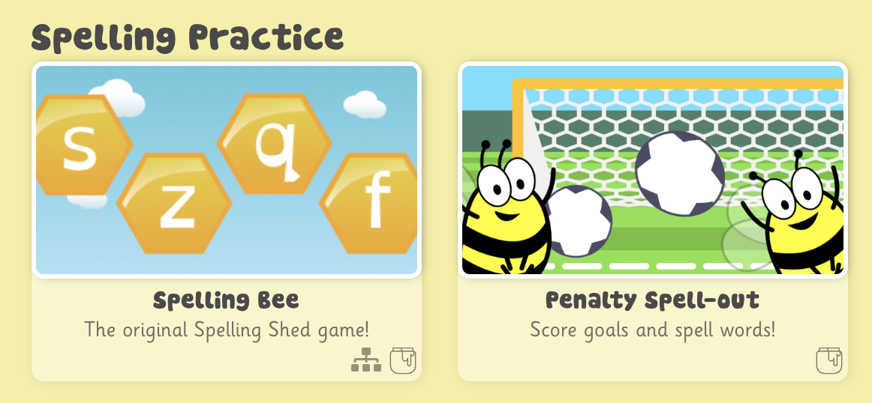
Writing & SPaG
• Writing inspired by history texts (e.g. Stone Age Boy).
• Genres: settings, narratives, diary entries, instructions.
• Daily handwriting (Letter-Join).
• New SPaG Ninja programme: capital letters, full stops,
conjunctions, tense, prepositions, inverted commas.
• Spelling Shed for home practice.

Slide 5


Maths
Autumn 1:
• Place value up to 1000
• Addition & subtraction
Autumn 2:
• Multiplication & division
Other:
• Times Tables Rockstars (daily practice)
• Active Maths – practical, fun sessions

Slide 6




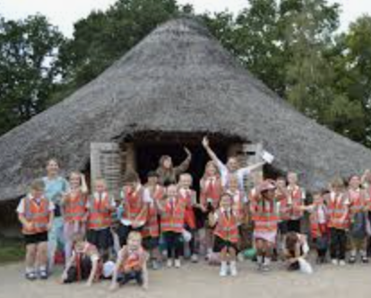
Wider Curriculum
• RE: Bible’s big story, Advent & Epiphany.
• Computing: Connecting computers & stop-frame animation.
• Science: Rocks, soils & fossils; Light & shadows.
• History: Pre-history (Stone Age to Iron Age).
• Trip: Celtic Harmony – Tue 23rd Sept 2025.

Slide 7

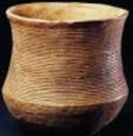
Creative Curriculum & PE
Art/DT:
• Autumn 1: Ammonites (sketching, shading, sculpture).
• Autumn 2: Prehistoric Pots (clay techniques).
PE:
• Autumn 1: Orienteering & gymnastics.
• Autumn 2: Ball skills & dance.
• PE Kit: Blue t-shirt, black/blue shorts.
• Kit in school Mon–Fri.

Slide 8

Homework & Communication
Homework:
• Daily: Reading (10 mins), spellings, times tables.
• Half-termly topic projects.
Communication:
• Year 3 webpage – regular updates.
• Contact via school office (sbm@st-james.enfield.sch.uk).

