Slide 1

Mr Kay

Slide 2
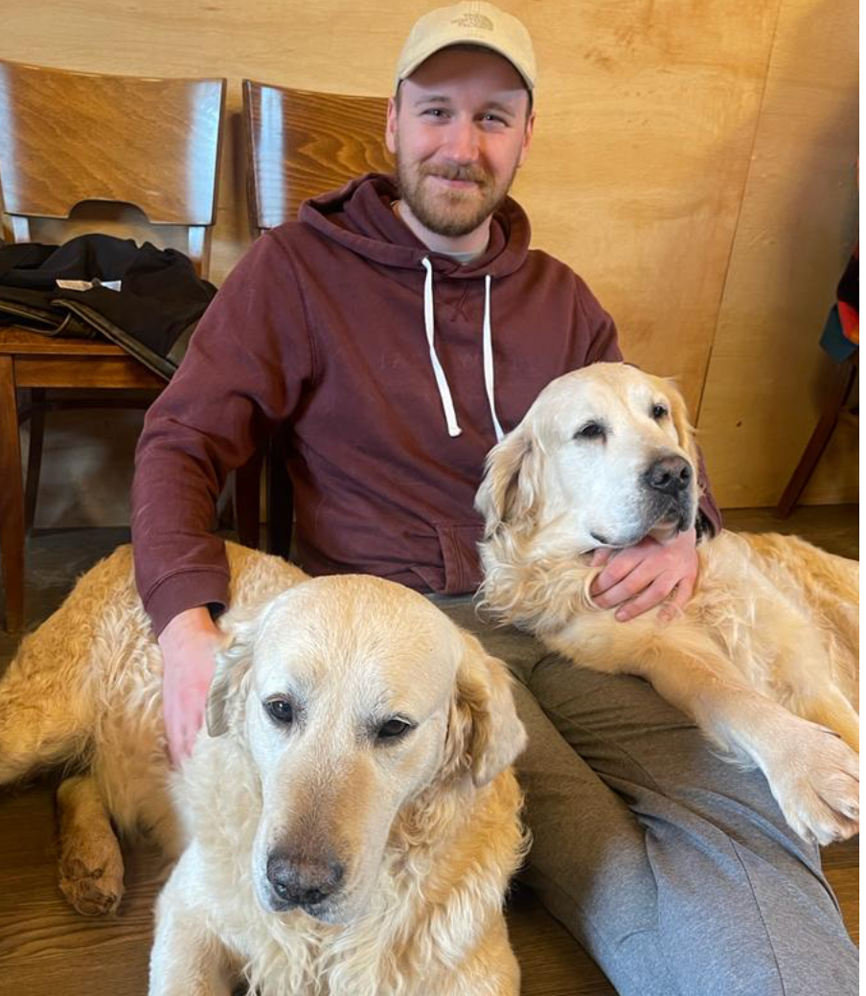
About Me!
Grew up locally
Teaching in Enfield
Love sport
Very excited to be at St James

Slide 3
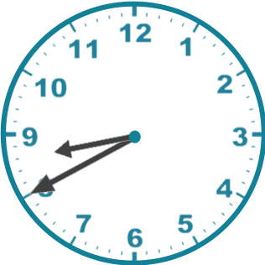
School Starts
Early morning work
Maths
Feedback
SPaG

Slide 4

Worship
EVERY DAY
In Class
Singing
Headteacher
Vicar and Values
Achievement
Class Value – Friendship assembly

Slide 5
Timetable

Slide 6
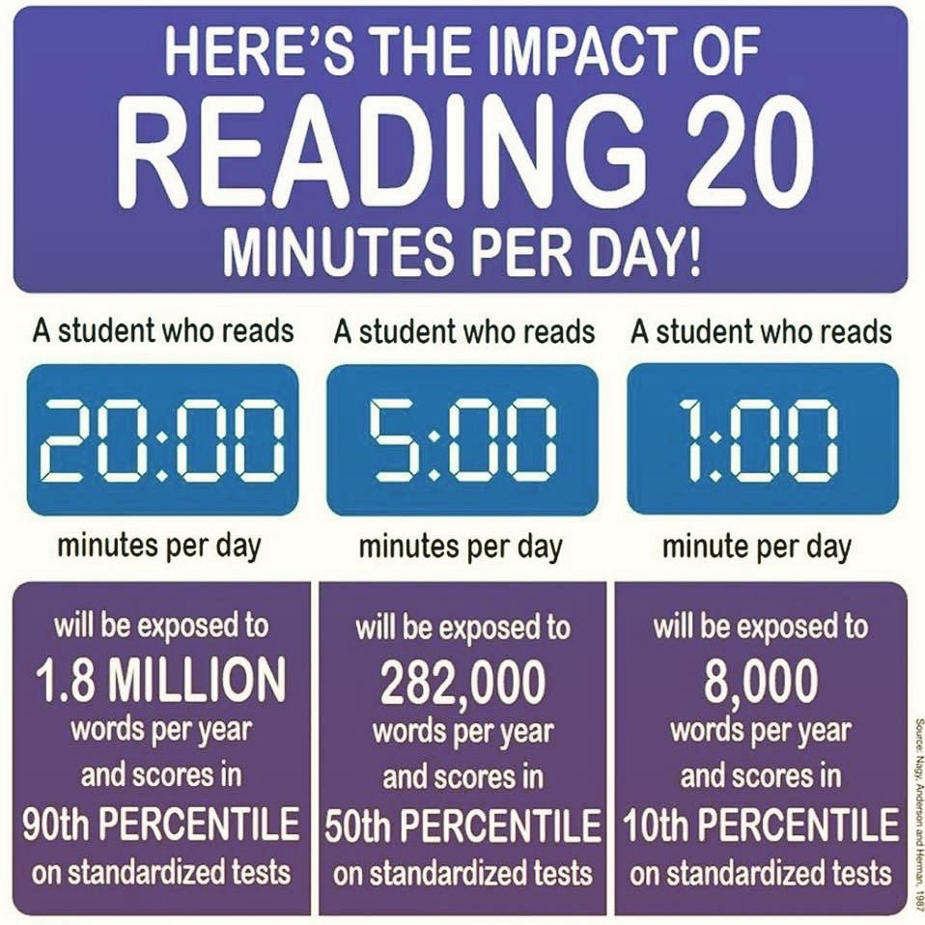

Reading
3 X per week in school
WHOLE SCHOOL EXPECXTATION
daily reading at home
sign reading record

Slide 7

English Writing
Daily English lesson linked to learning in Humanities
Pre & Post learning task– writing
Sequence of lessons – final assesses piece of writing

Slide 8

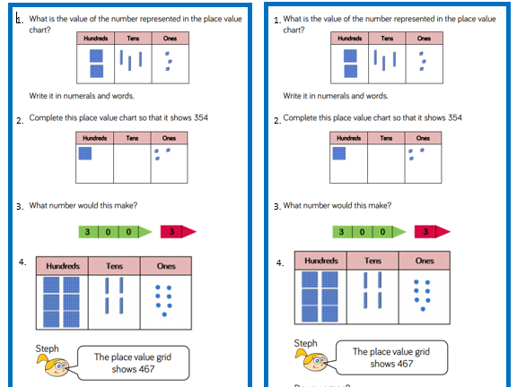

Maths
Taught daily
Homework – related to the learning in school
Smaller groups
Linked to schools White
Rose assessments
Sent home as homework to consolidate learning in class. Sent home near the end of a unit of work before final unit assessment.

Slide 9


Slide 10

PE
Every week on Tuesday and FRIDAY
Must GET CHANGED into school PE kit
Indoor (Tues) and Outdoor (Fri) PE lessons
Indoor with Vicky
Outdoor with Mr Kay

Slide 11

Homework
Spellings – weekly on a Friday
Maths – At the END of EACH Unit before final unit assessment
Reading – daily and sign Reading Record
History and Geography homework

Slide 12
Behaviour for Learning
The expectation is that all children adhere to the schools vision and values at all times
Children are expected to listen and work hard to reach their full potential (low level disruption e.g. talking when teacher is teaching is very time consuming and children lose concentration and become off task) this therefore has a huge impact on learning. If necessary I will inform individual parents after school. Sometimes children will miss some time of their playtime to reflect or catch up with their work
Parents to let me know if there are any circumstances at home that may affect concentration and learning in school (moving house / new baby etc)
Certificates awarded every week for excellent work or progress and demonstrating our school values in assembly every Friday – other rewards (stickers etc) awarded by myself and other adults
Reflection is conducted at lunchtime and you will receive a text message home to inform you that your child has spent time in reflection. I will also speak with you at the end of the school day to discuss the issue.

Slide 13
Mr Kay

