Slide 1



Schools & Children’s Services
Applying for a Secondary School 2026
Striving for excellence
www.enfield.gov.uk

Slide 2

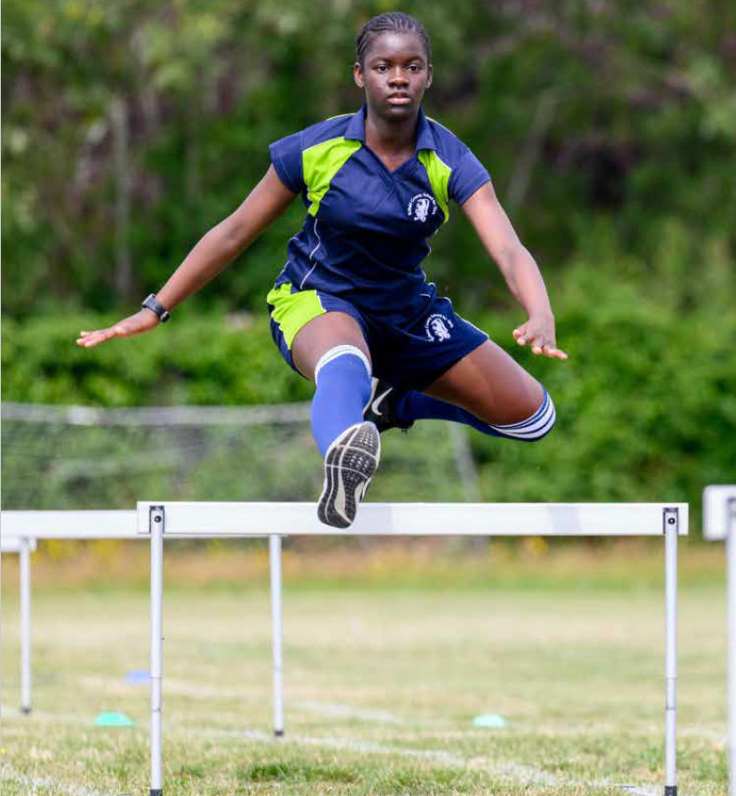
Types of Schools
Community – the Local Authority (elected Councillors) is responsible for deciding the admission arrangements for pupils
Foundation – the School’s Governing Body is responsible for deciding the admission arrangements for pupils
Voluntary Aided - the School’s Governing Body is responsible for deciding the admission arrangements for pupils
Academies and Free Schools–publicly funded state schools. The Academy Council or School Governors are responsible for deciding the admission arrangements

Slide 3
Schools in Enfield
AIM North London (A)
Bishop Stopford’s CE (VA)
Edmonton County (A)
Enfield Grammar (A)
Highlands (C)
Laurel Park School (F)
Lift Aylward
Oasis Academy Hadley (A)
St Ignatius College (VA )
Southgate ( A )
Winchmore ( C )
ARK John Keats (A)
Chace Community (C)
Enfield County School for Girls(C)
Heron Hall Academy (A)
Kingsmead (A)
Lea Valley Academy (A)
Oasis Academy Enfield (A)
St Anne’s Catholic High School
for Girls ( VA )
The Latymer (VA)
Wren Academy, Enfield (A)

Slide 4
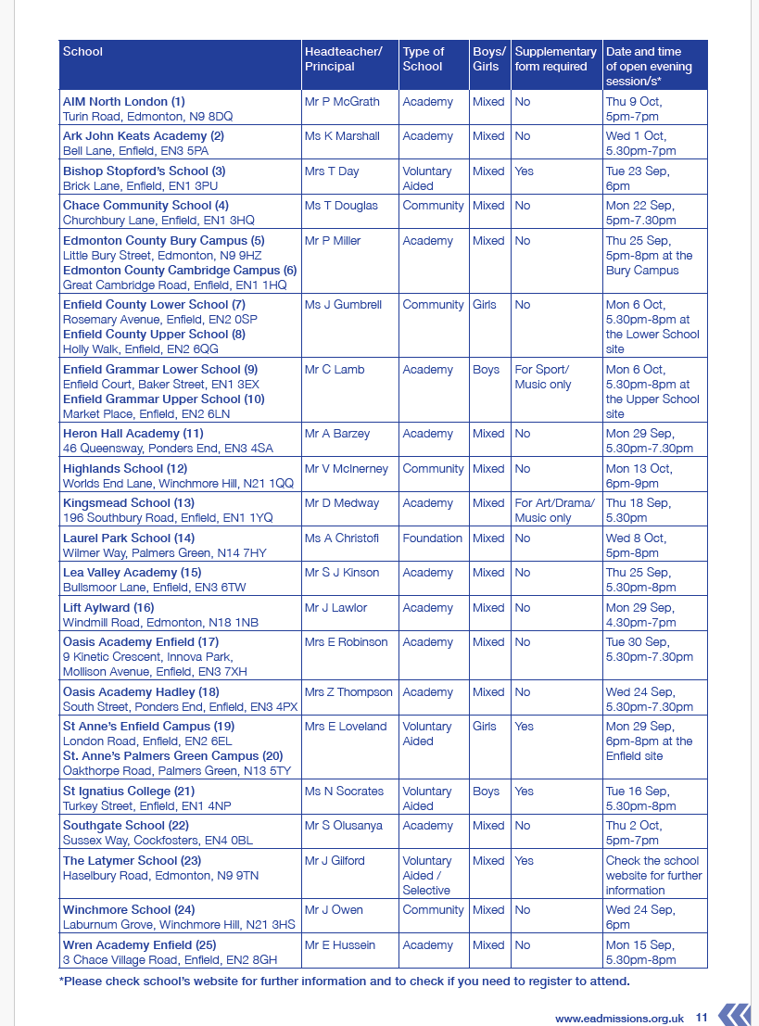
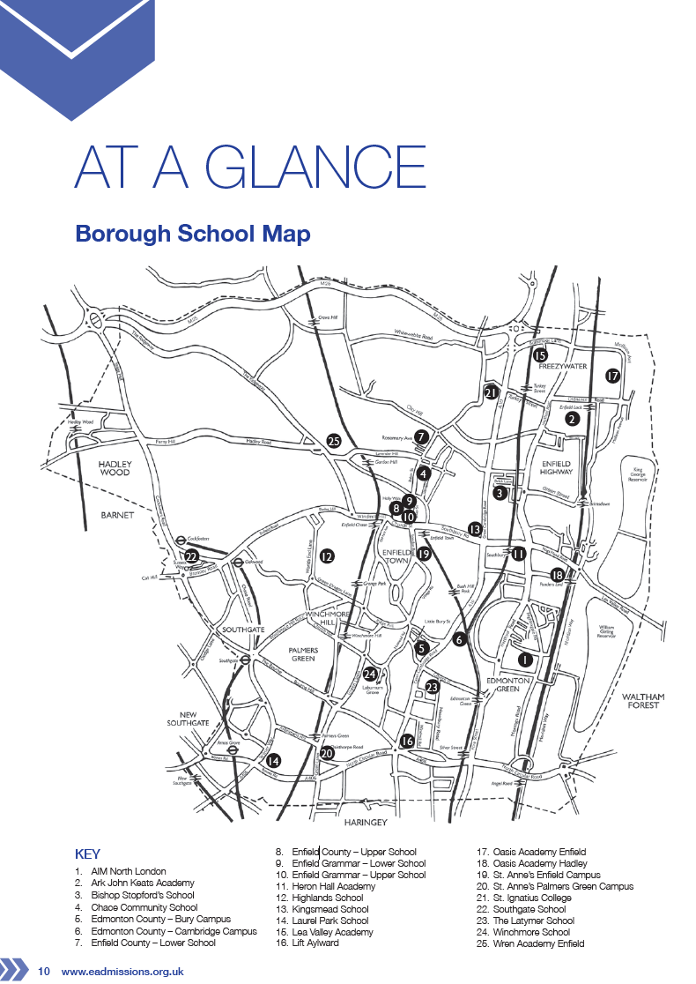
Information Booklet- page 10

Slide 5

Admission Criteria
Rules used to decide which children are offered places when there are more applications than places available.
Rules may differ between local authorities and types of schools.
Check school and local authority websites in case there are any changes to the information in LA booklets

Slide 6
Community School Admission Criteria (summary - see booklet for full details)
EHCP
Children in public care or previously adopted
Children for whom a particular
school is appropriate on
exceptional medical grounds
Children with a brother or sister
attending the school at the time
of admission (living at the same
address)
Children of members of staff
Children living nearest to the school
measured as the “crow flies”

Slide 7
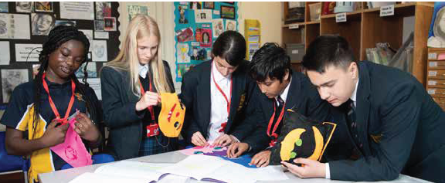
Exceptions
Chace Community –
priority zone for
nominated roads
Enfield County School
for Girls has a quota
system of allocation
Full details in
“Your Guide to Secondary
Schools in Enfield 2026 ” brochure available
online from September 2025.
https://www.enfield.gov.uk/__data/assets/pdf_file/0027/101979/Your-Guide-to-Secondary-Schools-in-Enfield-Sept-2026-Education.pdf

Slide 8
Partially or Fully Selective Schools
Selective schools will test children before the closing date for applications.
Children must be registered directly with the schools to be entered for the relevant selective tests/trials/auditions
Schools will let parents have the results of the tests/trial/audition before the closing date for the Borough application.

Slide 9
What can Enfield parents expect?
One local authority application for all maintained schools (community, foundation, voluntary aided, free school and academy) regardless of where the school is located
National closing date for the submission of forms –
31st October 2025
6 preferences allowed in London (Hertfordshire will only accept four Hertfordshire schools – don’t include more)
Equal consideration given to each school asked for; E.G a 6th preference is ranked higher than a 1st preference if you live closer and it comes to distance criteria.

Slide 10

What can Enfield parents expect?
We will apply for schools outside the area on your behalf.
We can only accept late applications or changes of preference after the deadline in exceptional circumstances
If your child is eligible for more than one school, your preference order will be used to decide the final offer
Single offer emailed on 2nd March 2026

Slide 11
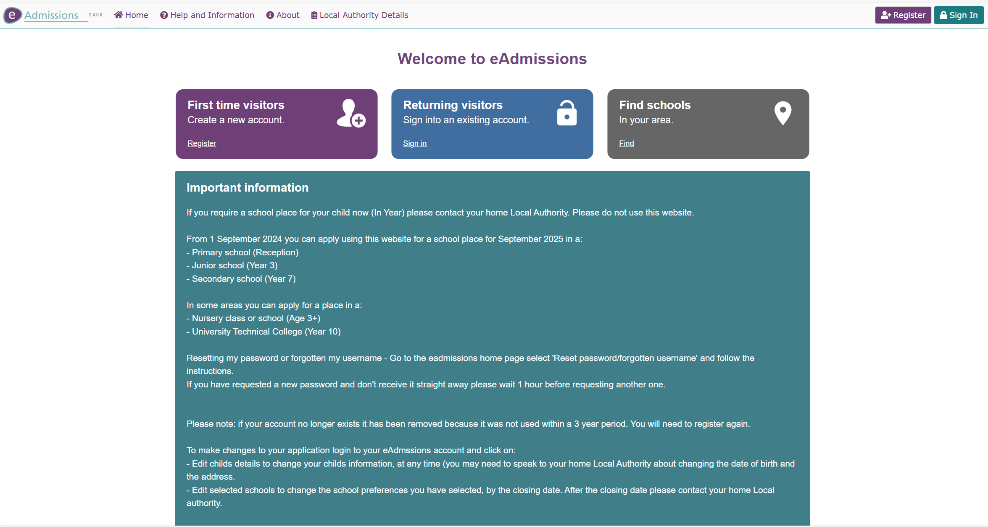
How to apply - www.edmissions.org.uk

Slide 12

Online Applications
It is quick and easy to do – just register and follow the instructions
You will get an email confirmation once you submit your application
The online system checks that you are completing all the right sections of the application
The online system is available 24 hours a day, 7 days a week until midnight on the closing date
You can get your result on the evening of 2 March 2026 and then either accept and decline your offer online

Slide 13

Making your application
  Make sure you tell us…
  If the child is looked
  after or adopted?
  If there are brothers or sisters will be attending any of the schools applied for when you start?
  Does a parent work at any of the schools listed on your form?

Slide 14
Making your application
Provide supporting documentation with your application if you are asking for medical priority
  Be sure the address you use is the child’s usual place of residence. Attach details if not
  Include your council tax reference number in your application.
  Complete any supplementary forms and send them directly to the schools
  Meet all the deadlines

Slide 15
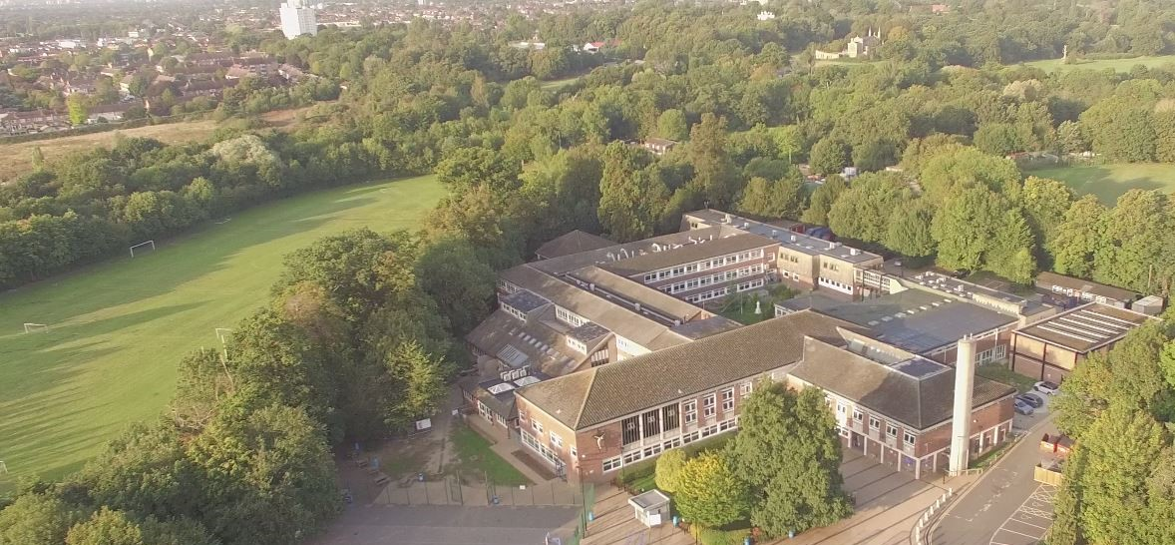
Enfield Schools - What happened this year
The furthest distance a place was offered for admission in September 2025 on national offer day (3 March 2025).
ARK John Keats - 0.501 miles
Edmonton County – 4.557 miles
Highlands - 0.904 miles
Kingsmead – 1.144 miles
Southgate – 3.153 miles
Winchmore – 0.727 miles
Please see the information booklet for further details on historical distances

Slide 16

Things to remember…
Find out more about all the schools you are interested in, especially those in your local area.
Check out school websites for up-to-date information about opportunities to visit – open evenings are planned but schools may have to make changes at short notice.
Look at the previous years admissions data and criteria.
Distance counts for many schools and will often be a deciding factor if there are more applications than places available.
https://www.enfield.gov.uk/__data/assets/pdf_file/0027/101979/Your-Guide-to-Secondary-Schools-in-Enfield-Sept-2026-Education.pdf

Slide 17
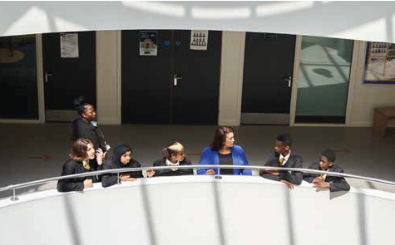
Things to remember
  If you are considering schools
  outside Enfield, look at other
  authority websites for details
  as it may be different to Enfield’s
  Check if you need to complete a
  supplementary information form
  Complete all applications in full
  Nominating only one school will not improve your chance of getting a place. Nor will putting the same school multiple times – if you do this your application will only be considered after all other application have been processes
  Be aspirational but also realistic

Slide 18

Things to remember
Make an informed decision. Consider first hand, accurate and up to date information
Speak to your child’s primary school
Be realistic.

Slide 19
Why choose a school in Enfield
We asked the Head of our School Improvement Service why parents should choose a school in Enfield, we were advised that:
There are 21 amazing maintained secondary schools in the Enfield.
There is so much that is excellent about education in the borough. Here are a few examples of how Enfield schools are leading the way:
100% of Enfield schools are graded as good or better by Ofsted.

Slide 20

Why choose a school in Enfield - continued
Work from some Enfield schools has been highlighted nationally – both work done by teachers and work in support from the Education Service.
We support schools in sharing good practice.
Enfield Music Service support children and young people.
Enfield High Achievers Event celebrates the best academic outcomes of pupils in Year 11

Slide 21

Any questions?

